Slide 1
LECTURE 4

Slide 2
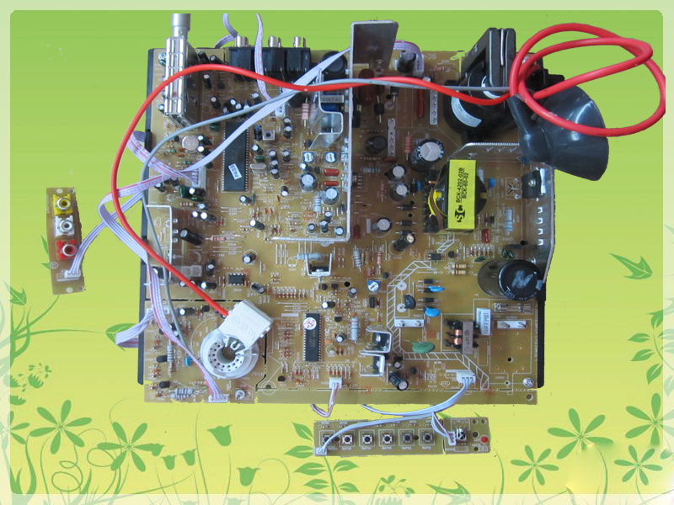


Circuit of television
To make drawing of
circuits easy
Lets learn
Electrical Symbols

Slide 3


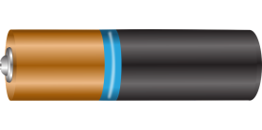
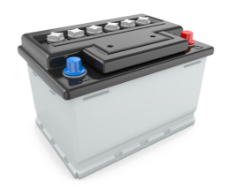
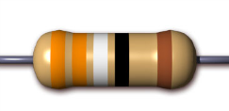
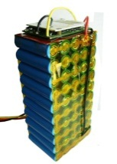

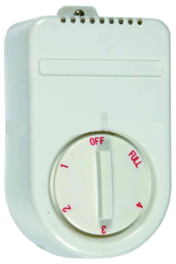
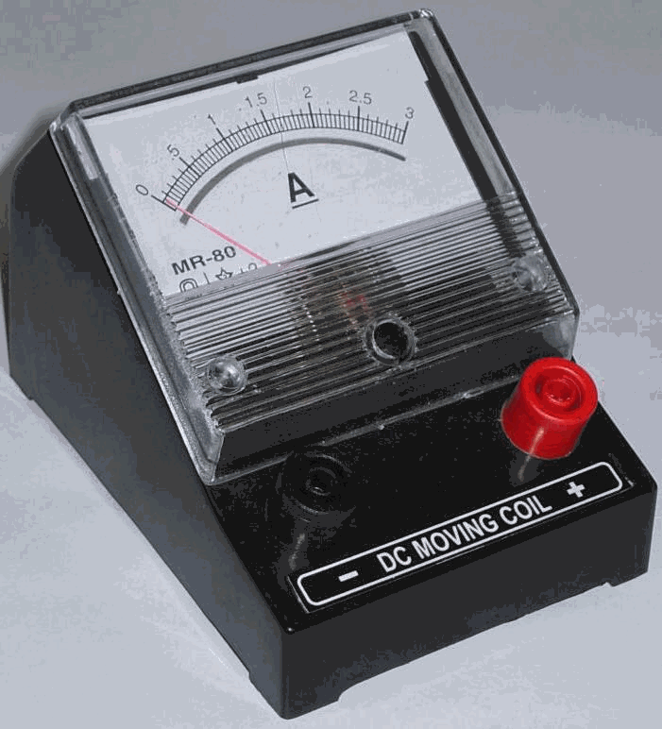
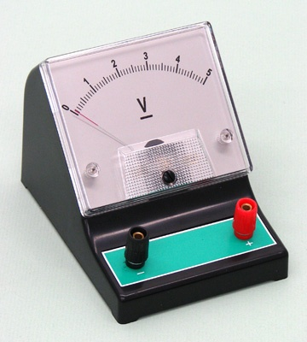
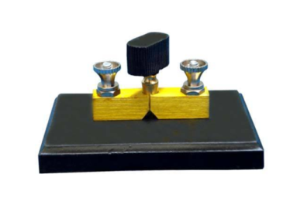
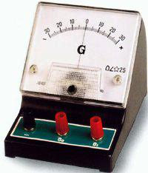
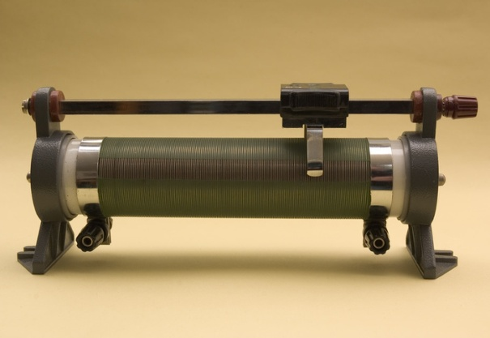



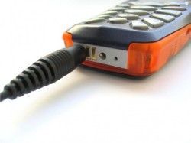
ELECTRICAL SYMBOLS
-
+
Measuring Instruments
Cell
Variable known Resistance
+
-
+
-
-
Variable known
Resistance
+
A
V
Ammeter
Voltmeter
Resistance
+
-
Battery
G
Galvanometer
KEYS / SWITCHES
Plug key
Tap key
.
( )
Closed
(On)
Closed
(On)
Variable Resistance
( )
Open
(Off)
Open
(Off)

Slide 4
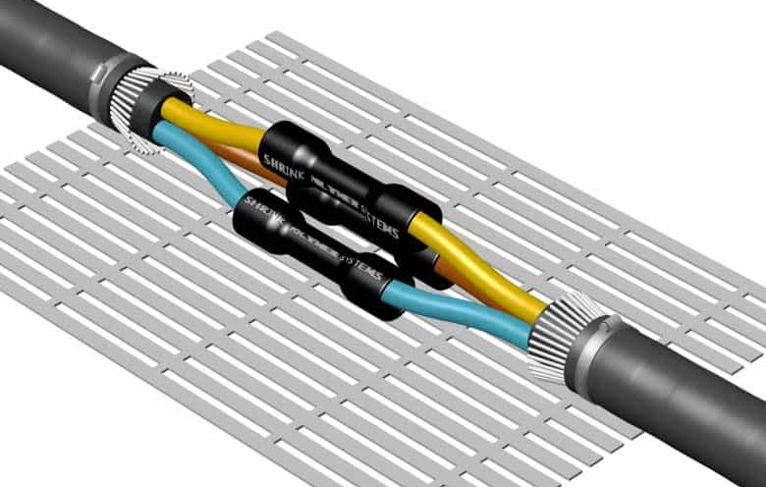
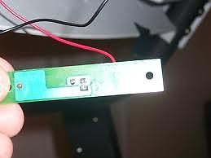
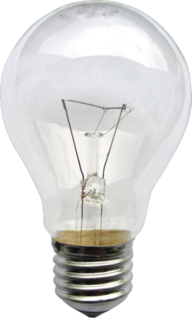
A wire joint
Wire crossing
Electric bulb

Slide 5

+
–
+
–
+
–
A
Draw the symbols of components required to make the circuit
Cell
Resistance
Battery
Ammeter
IT’S TEST TIME
+
–
+
–
V
G
Variable Resistance (Unknown)
Variable Resistance
(known)
Voltmeter
Galvanometer
.
( )
Plug key(on)
Tap key (on)
A wire joint
Electric bulb
( )
Plug key(off)
Tap key (off)
Wire crossing

Slide 6
SOME IMPORTANT POINTS TO REMEMBER
+
-
While connecting cells to each other always connect unlike terminals.
+
-
A
For devices like ammeter or voltmeter, the side from which current enters is positive (+) and the side from current exits is negative (-).
+
-
V

Slide 7
SOME IMPORTANT POINTS TO REMEMBER
+
–
–
+
A
( )
As the current in the circuit is not divided
It is made from a material having infinite resistance
Ammeter is connected in series with the cell.
So the current it allows is negligible or almost zero
+
–
V
So it allows almost entire current to pass
So it doesn’t disturb the current as well as measures the current
It has very low resistance
A
B
+
–
–
+
A
( )
As the current in the circuit is divided
Voltmeter
Ammeter
Voltmeter is connected in parallel with the cell.

Slide 8
Q.1.
How is a voltmeter connected in the circuit to measure the potential difference between two points?
Ans. :
To measure the potential difference between two points, voltmeter must always be connected in parallel to the points.
Q.2.
What happens if an ammeter is connected in parallel?
Ans. :
If an ammeter is connected in parallel, the resultant resistance of the circuit decreases and more current passes through the ammeter. Hence, the ammeter is likely to be burnt.
Q.3.
What happens if a voltmeter is connected in series?
Ans. :
When the voltmeter is connected is series, the resistance of the circuit becomes high and there is considerable fall in current through the circuit. Thus, the voltmeter will not give the correct reading of the potential difference.

Slide 9
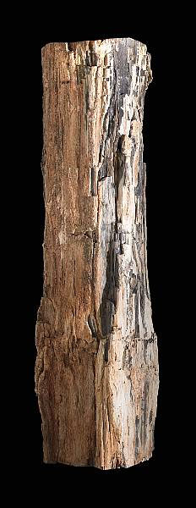
How many mistakes can you find in this diagram
+
-
V
A
-
+
+
-
A
( )
V

Slide 10
Experimental verification of Ohm’s law
+
–
V α I
and = R (Constant)
Linear
4
I
3
(6, 3)
+
–
A
2
(4, 2)
+
–
V
8
Nichrome wire
Length : 3 m
Diameter : 0.02 cm
1
(2, 1)
No of Cells | I (A) | P.D (V)
= R (Ω)
6
O
1
1
2
2
V
4
2
2
4
2
3
3
6
2
2

Slide 11
Thank You

